Slide 1
PC Maintenance: Preparing for A+ Certification
Chapter 28: Working with Applications

Slide 2
Chapter 28 Objectives
Install and remove applications
Configure DOS applications
Use Compatibility mode
Troubleshoot problems with applications

Slide 3
What Does Application Installation Do?
Copies files to hard disk
Sets up shortcuts
Edits Registry

Slide 4
Installing Windows Applications
Autoplay from CD (Autorun.inf file)
Double-click Setup file in file listing
Unzip ZIP file and run Setup

Slide 5
Installing an Application that Has No Setup Utility
Copy to the hard disk
Manually create a shortcut for it
No change required to Registry

Slide 6
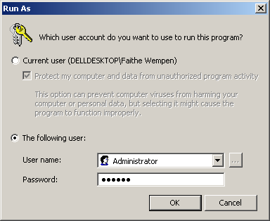
Installation Security Issues
Must be Administrator
Right-click Setup.exe, choose Run As, run as an Administrator

Slide 7
Controlling Whether Application Loads at Startup
Making an application load
  Add a shortcut to the Startup folder
Preventing an application from loading
  Disable autostart in its Properties
  Disable from MSCONFIG

Slide 8
Removing Windows Applications
Use application’s own Uninstall utility if possible
Remove using Add/Remove programs
Manual removal is last resort
  Delete application’s files
  Delete shortcuts
  Manually remove entries from Registry (optional, debatable whether benefits outweigh risks)

Slide 9
Troubleshooting Application Removal Problems
Uninstall info contained in a log file (ex. INSTALL.LOG) or in a Microsoft Installation file (.MSI extension)
If uninstall data is missing, application might not remove correctly
Try reinstalling and then removing

Slide 10
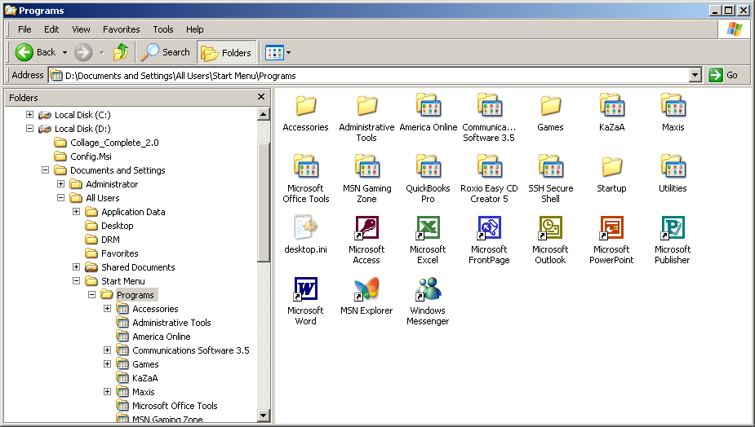
Reorganizing the Programs Menu
Drag items around on Start menu
Right-click Start button and choose Open All Users

Slide 11
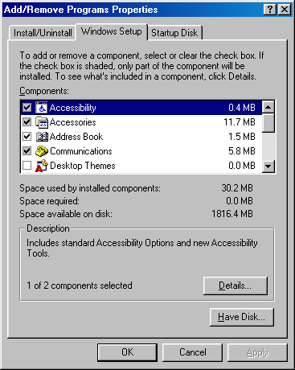
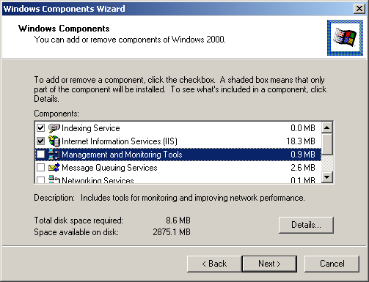
Adding and Removing Windows Components
Add/Remove Programs in Control Panel

Slide 12
Potential Issues with DOS Programs Under Windows
CONFIG.SYS and AUTOEXEC.BAT modifications
Resource sharing
  DOS applications assume exclusivity
Proprietary video drivers
Proprietary sound drivers

Slide 13
Potential Issues with DOS Programs Under Windows
Working directory
Shortcut key conflicts
Switching problems
Stated incompatibility with Windows
Crashes under Windows

Slide 14
Installing a DOS Application
Run from a command prompt (optional but can be helpful)
Do not allow it to make changes to startup files
Test after installation
Modify PIF through application’s Properties if needed
Create Windows shortcut(s)

Slide 15
Understanding PIFs
Program Information File
Shortcut used to store settings for MS–DOS applications
.PIF extension under 9x versions
Still exist under 2000/XP but no .PIF extension

Slide 16
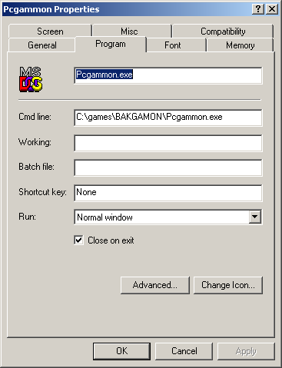
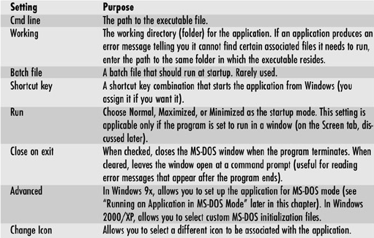
Properties for PIF

Slide 17
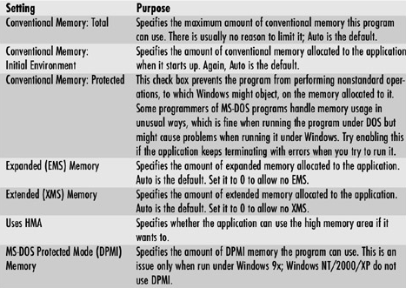
Properties for PIF

Slide 18
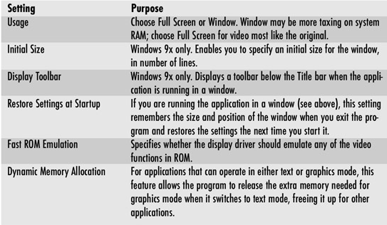
Properties for PIF

Slide 19
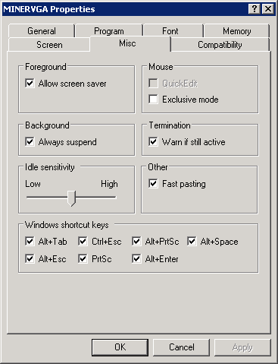
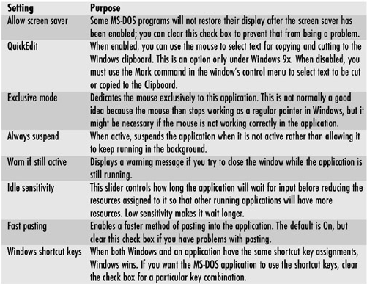
Properties for PIF

Slide 20
Compatibility Mode
Only in Windows XP
Only simulates earlier 32-bit Windows versions
Does not create compatibility for Windows 3.x or DOS
Two methods:
  Compatibility Wizard
  Manual setup through application’s Properties

Slide 21
Troubleshooting Applications
General Protection Fault (GPF)
  Application attempts to do something that would compromise stability
  “Blue screen of death”
  Reboot
  If recurring problem, reinstall file or application causing the problem

Slide 22
Troubleshooting Applications
Illegal Operation
  Similar to GPF but confined to a single application
  Dialog box (not blue screen)
  Restart application
  If reoccurs, restart PC
  Check for availability of patch or update

Slide 23
Troubleshooting Applications
Lockups
  Switch away from unresponsive application to other applications and save your work if possible
  Display Task Manager and attempt to shut down the unresponsive program
  Restart Windows
  Last resort: Press and hold Power button for 5 seconds

